Slide 1

Platformer with cat
20211155,korennova iuliia

Slide 2
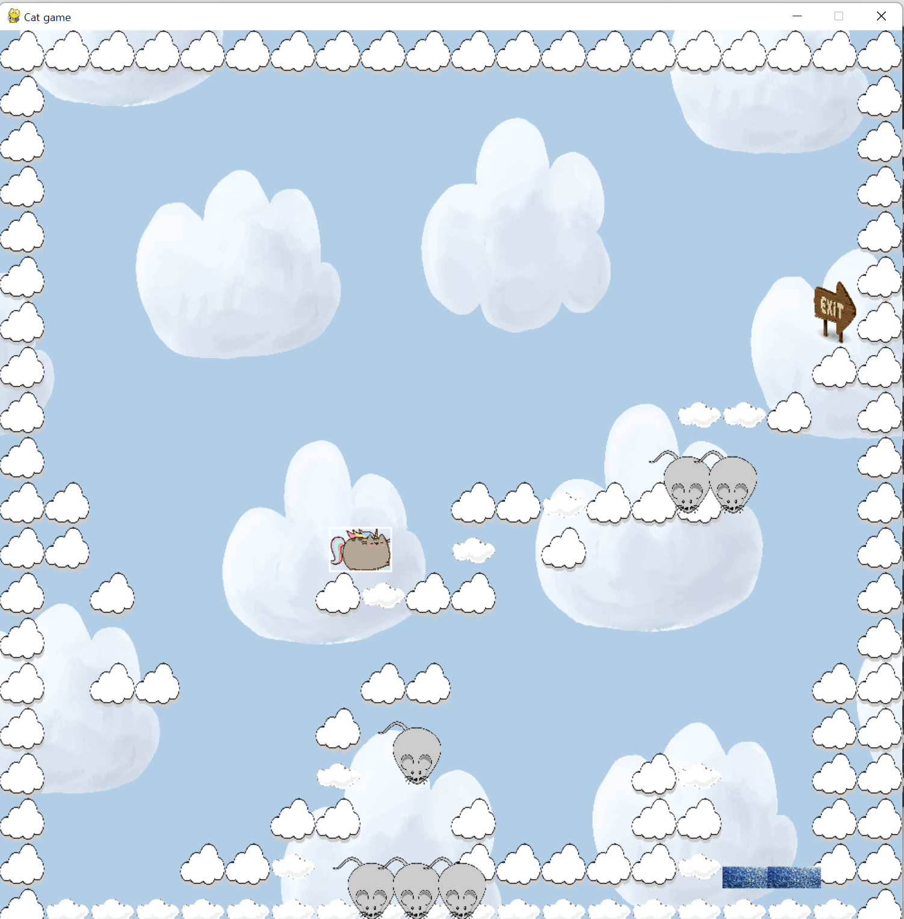
First idea and result
First idea was to make a game similar to bunny jumping game
In result it became jumping platformer
Cat-unicorn is jumping on the clouds, avoiding enemies and gets to the exit
What in the end of all levels? You’ll when you’ll get to the end

Slide 3

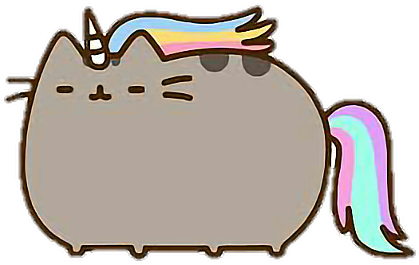
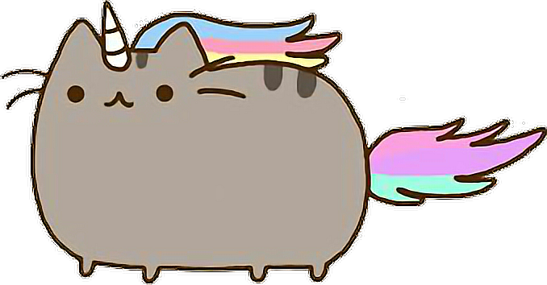
Player
Player is cat from Facebook stickers – Pusheen as a unicorn
Player has animation for creating an effect of walking, I have 3 images for this
It’s changing it’s direction together with the desired movement to the right or left
for num in range(1, 3):
img_left = pygame.image.load(f'cat_game/cat{num}.png')
img_left = pygame.transform.scale(img_left, (70, 50))
img_right = pygame.transform.flip(img_left, True, False)
self.images_right.append(img_right)
self.images_left.append(img_left)

Slide 4
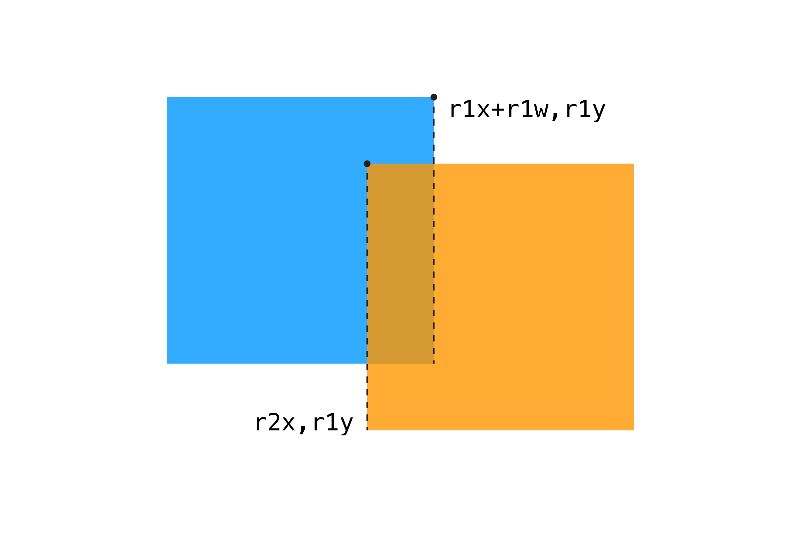
Collision by rectangles
Collision of objects happens when 2 rectangles overlap and produce 3d rectangle

Slide 5
Fortunately, there is pygame.Rect.colliderect exists

Slide 6
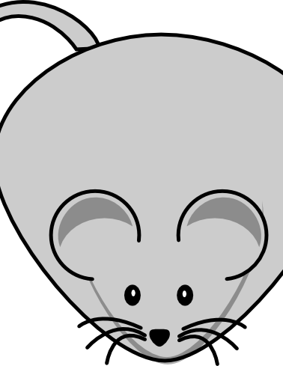
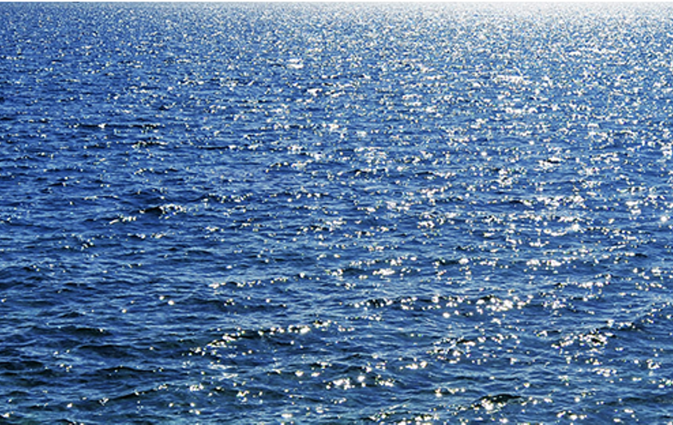
Enemies
2 enemies:
Rat and Water
def __init__(self, x, y):
pygame.sprite.Sprite.__init__(self)
img_rat = pygame.image.load('cat_game/mouse.png')
self.image = pygame.transform.scale(img_rat, (70, 70))
self.rect = self.image.get_rect()
self.rect.x = x
self.rect.y = y
self.move_direction = 1
self.move_counter = 0
#making new update class for enemies moving left and right in the same point
def update(self):
self.rect.x += self.move_direction
self.move_counter += 1
if abs(self.move_counter) > 30:
self.move_direction *= -1
self.move_counter *= -1

Slide 7
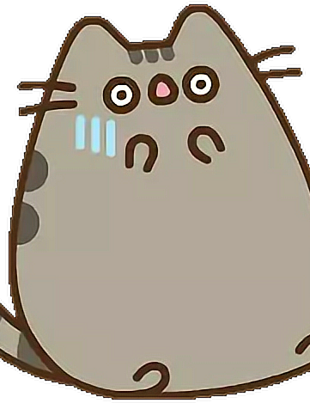
Player’s death
When cat sees the rat or falls down to the water it’s get scared to death and flies away to the heaven
There are no additional lives but player can restart from the same level where he died
There is a reset function in Player’s class to start the game again

Slide 8
def reset(self, x, y):
self.images_right = []
self.images_left = []
self.index = 0
self.counter = 0
for num in range(1, 3):
img_left = pygame.image.load(f'cat_game/cat{num}.png')
img_left = pygame.transform.scale(img_left, (70, 50))
img_right = pygame.transform.flip(img_left, True, False)
self.images_right.append(img_right)
self.images_left.append(img_left)
dead = pygame.image.load('cat_game/cat_scared.png')
self.dead_img = pygame.transform.scale(dead, (60, 80))
self.image = self.images_right[self.index]
self.rect = self.image.get_rect()
self.rect.x = x
self.rect.y = y
self.vel_y = 0
self.width = self.image.get_width()
self.height = self.image.get_height()
self.jumped = False
self.direction = 0
self.in_jump = True

Slide 9

Exit
Exit shows where the player can go to finish the level and move to the next one
def __init__(self, x, y):
pygame.sprite.Sprite.__init__(self)
img = pygame.image.load('cat_game/exit.png')
self.image = pygame.transform.scale(img, (tile_size, int(tile_size * 1.5)))
self.rect = self.image.get_rect()
self.rect.x = x
self.rect.y = y

Slide 10


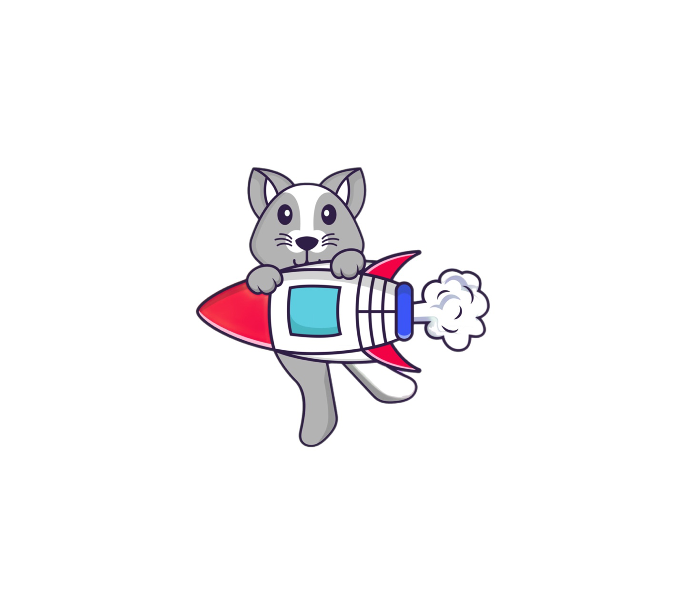
What’s planning?
At the moment, there are only 5 levels, but more are expected.
Each level is harder and longer than the previous one
More enemies will be added
Rewards and lives will be added
More sound effects – when cat dies, when gets closer to enemies, when jumps and when gets the reward
More animation of the player – when player doesn’t move for a while

Slide 11
Check my github juniajeff and follow it ;)

